Slide 1

© 2011, Mike Murach & Associates, Inc.
Slide <number>

Slide 2
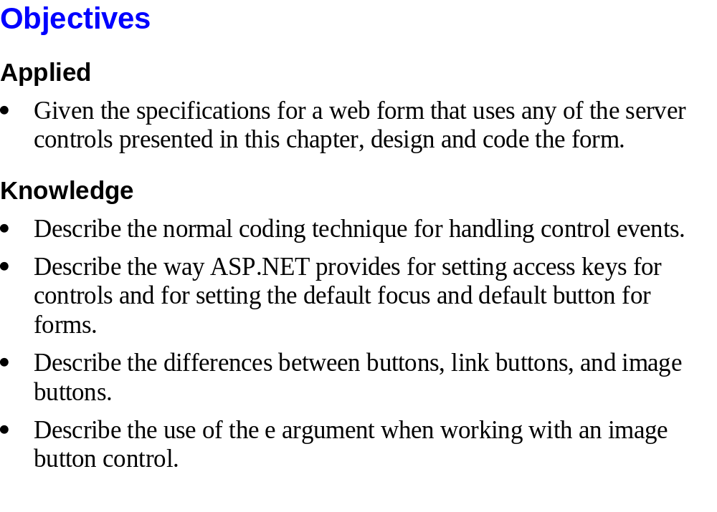
© 2011, Mike Murach & Associates, Inc.
Slide <number>

Slide 3
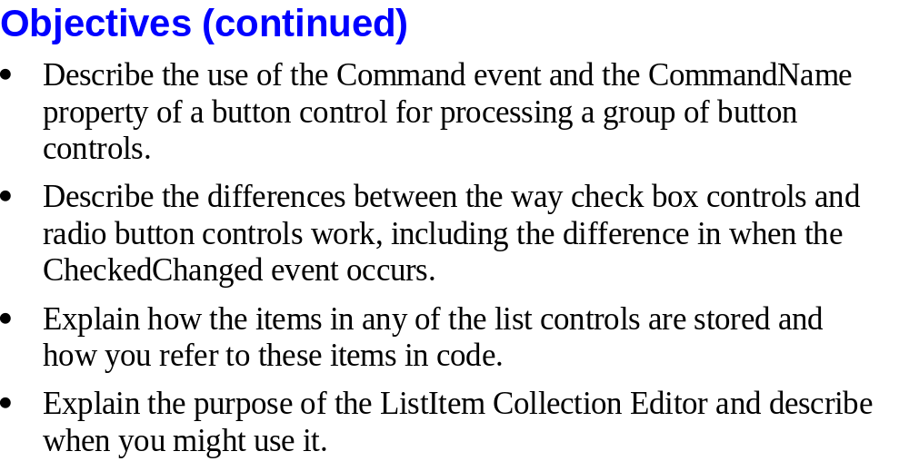
© 2011, Mike Murach & Associates, Inc.
Slide <number>

Slide 4
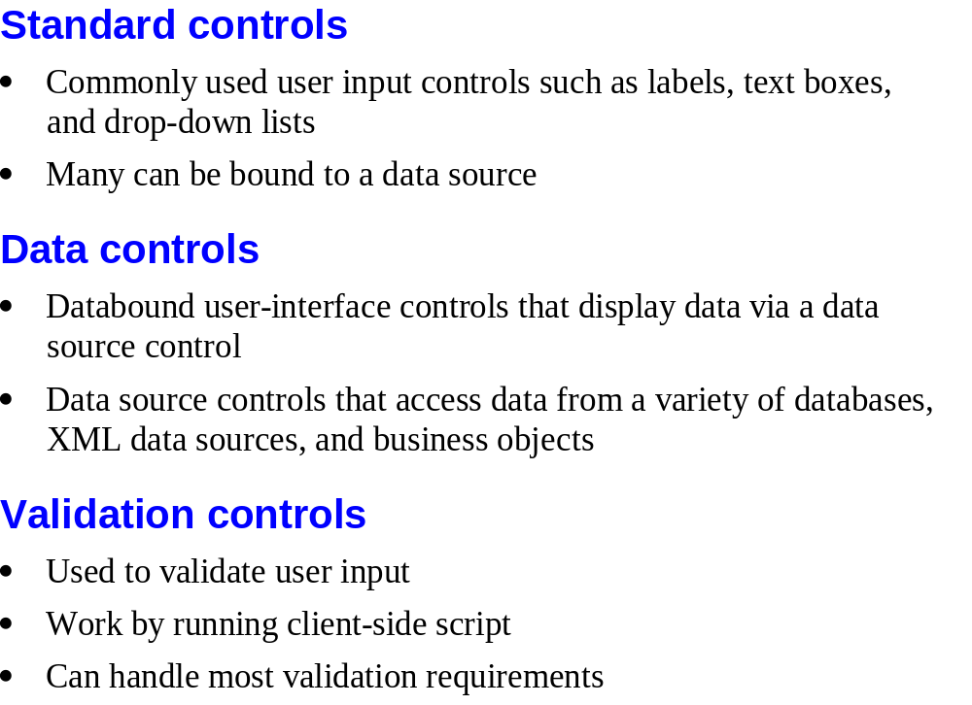
© 2011, Mike Murach & Associates, Inc.
Slide <number>

Slide 5
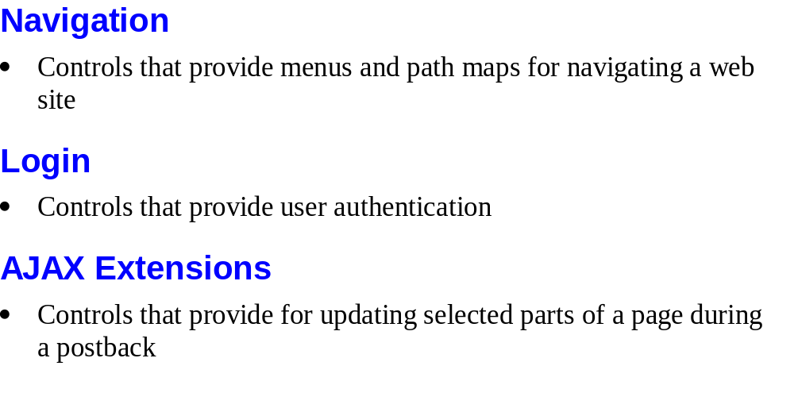
© 2011, Mike Murach & Associates, Inc.
Slide <number>

Slide 6
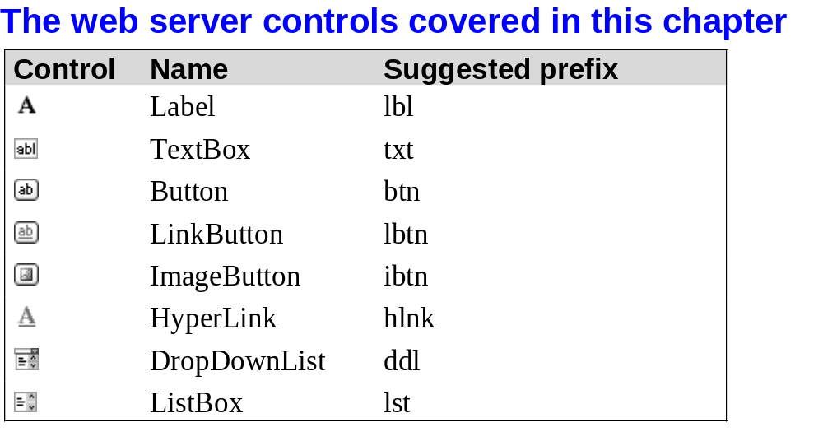
© 2011, Mike Murach & Associates, Inc.
Slide <number>

Slide 7
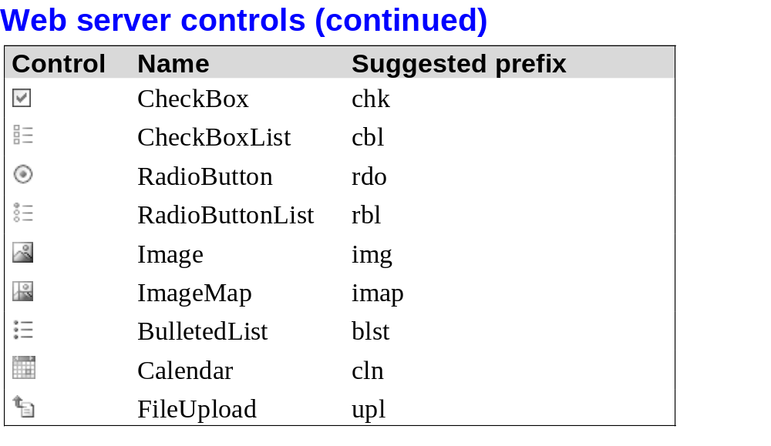
© 2011, Mike Murach & Associates, Inc.
Slide <number>

Slide 8
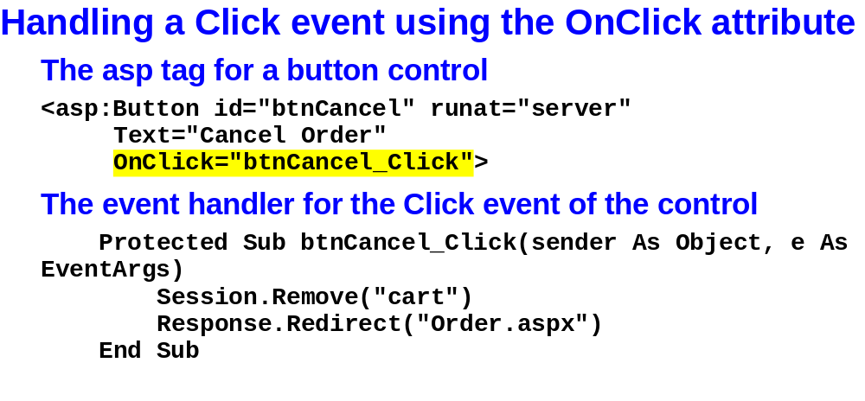
© 2011, Mike Murach & Associates, Inc.
Slide <number>

Slide 9
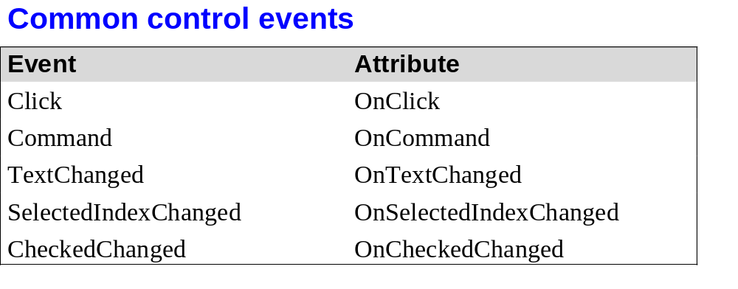
© 2011, Mike Murach & Associates, Inc.
Slide <number>

Slide 10

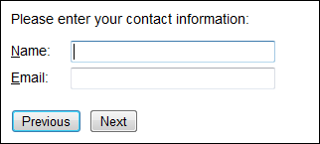
© 2011, Mike Murach & Associates, Inc.
Slide <number>

Slide 11
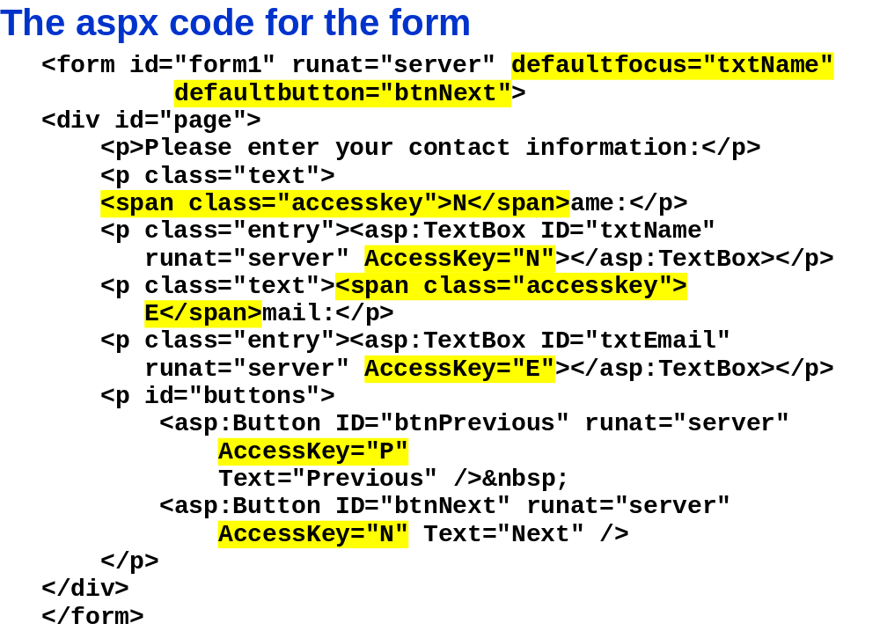
© 2011, Mike Murach & Associates, Inc.
Slide <number>

Slide 12
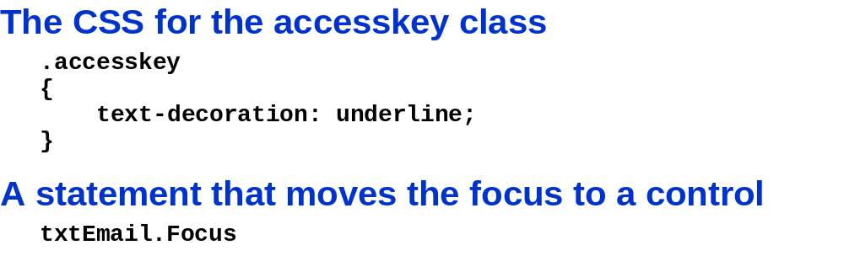
© 2011, Mike Murach & Associates, Inc.
Slide <number>

Slide 13
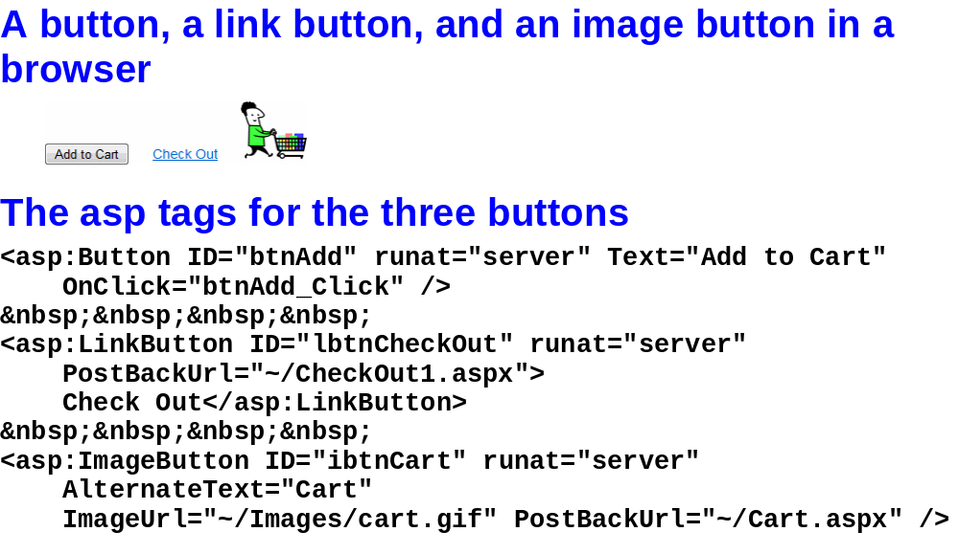
© 2011, Mike Murach & Associates, Inc.
Slide <number>

Slide 14
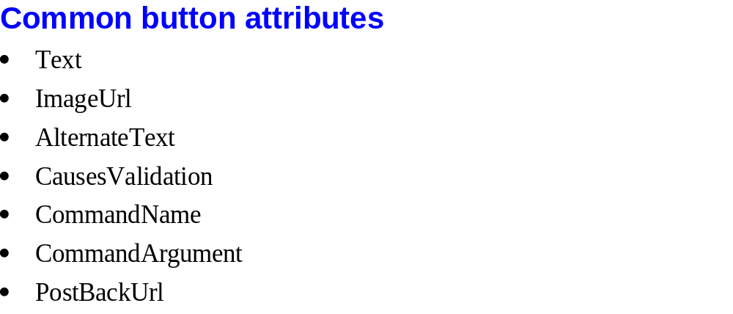
© 2011, Mike Murach & Associates, Inc.
Slide <number>

Slide 15
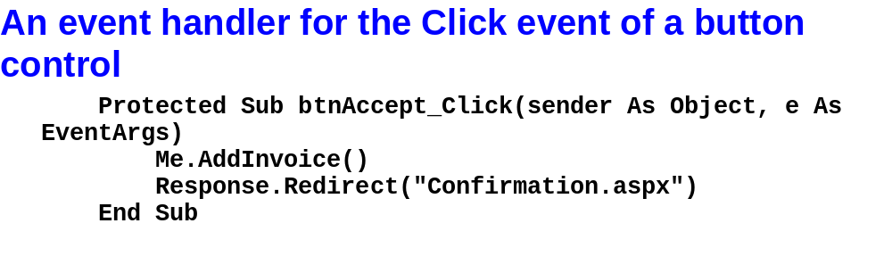
© 2011, Mike Murach & Associates, Inc.
Slide <number>

Slide 16
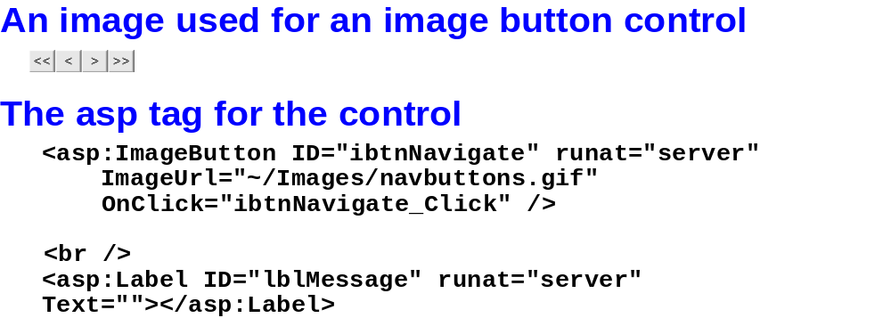
© 2011, Mike Murach & Associates, Inc.
Slide <number>

Slide 17
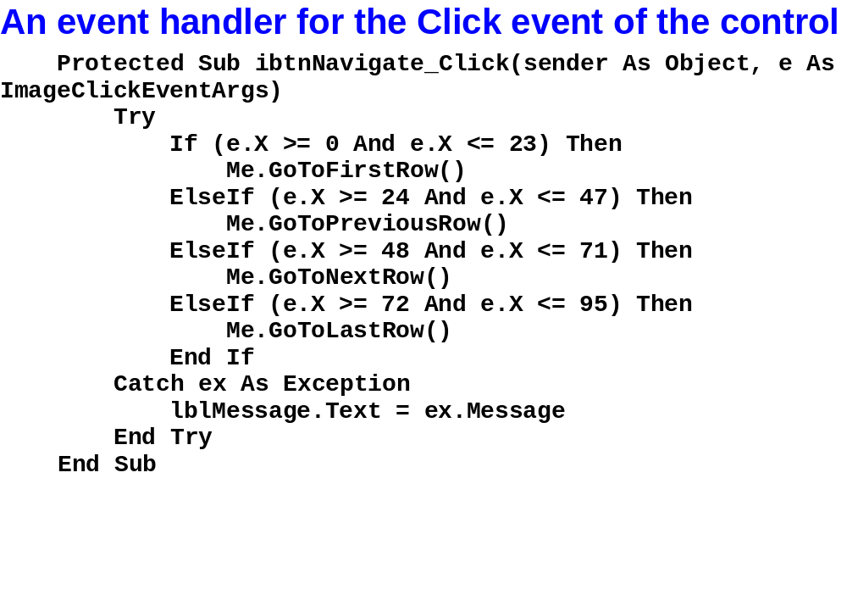
© 2011, Mike Murach & Associates, Inc.
Slide <number>

Slide 18
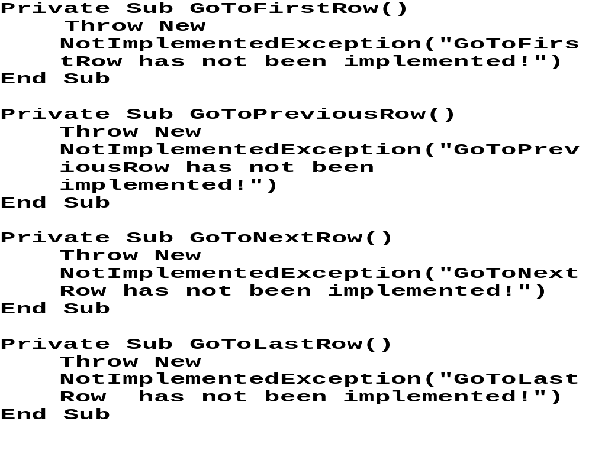
© 2011, Mike Murach & Associates, Inc.
Slide <number>

Slide 19
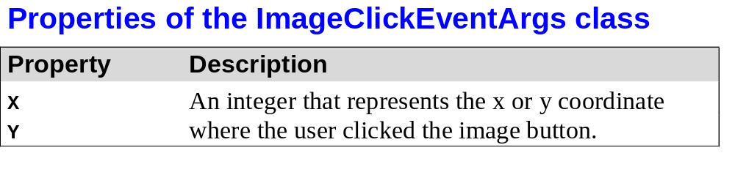
© 2011, Mike Murach & Associates, Inc.
Slide <number>

Slide 20
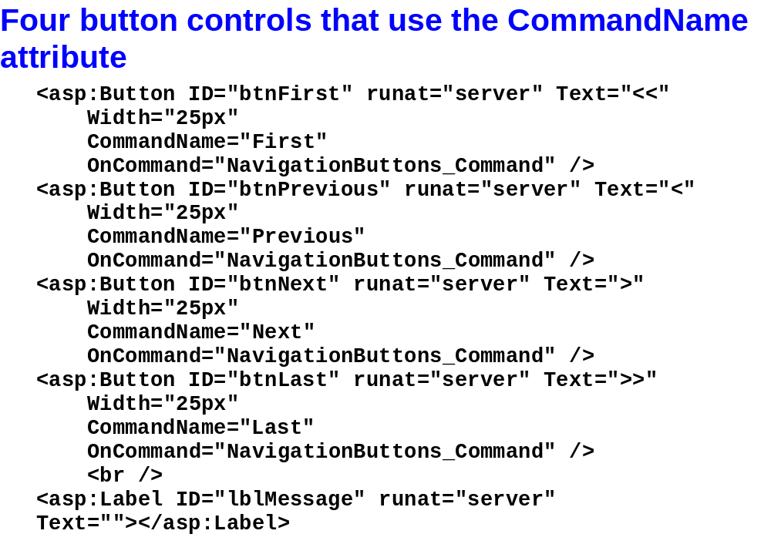
© 2011, Mike Murach & Associates, Inc.
Slide <number>

Slide 21
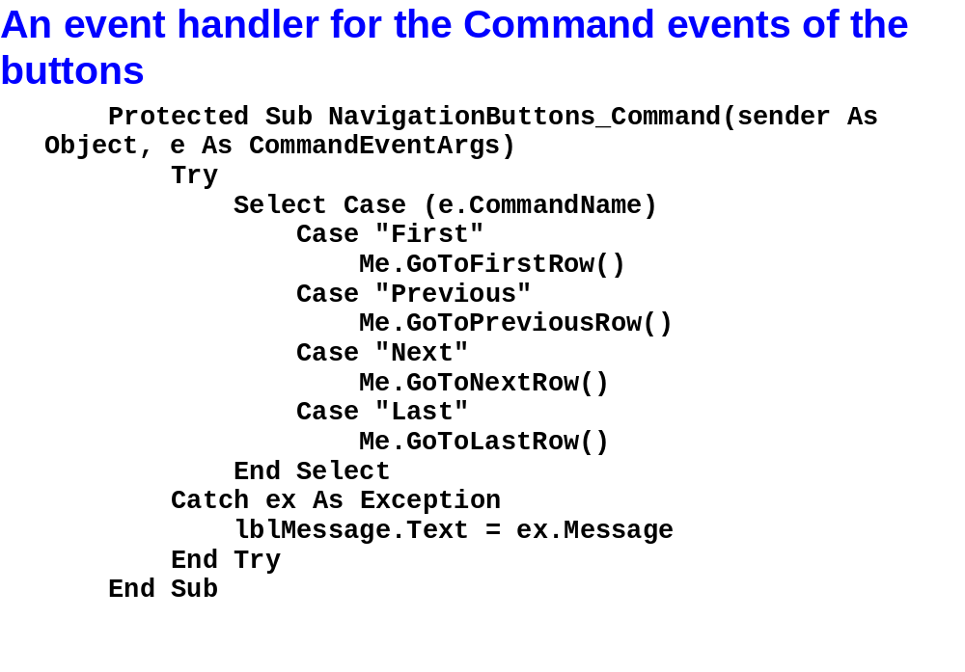
© 2011, Mike Murach & Associates, Inc.
Slide <number>

Slide 22
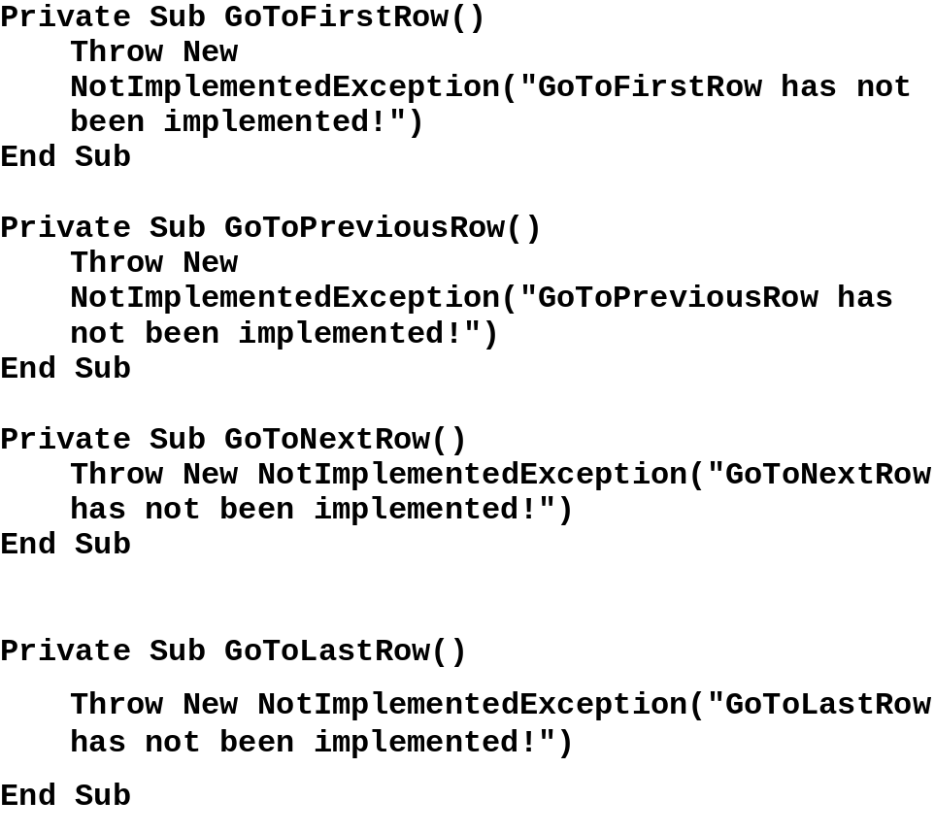
© 2011, Mike Murach & Associates, Inc.
Slide <number>

Slide 23
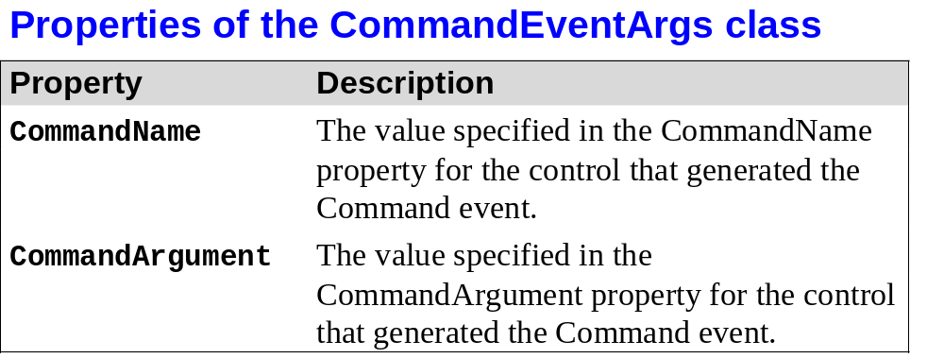
© 2011, Mike Murach & Associates, Inc.
Slide <number>

Slide 24
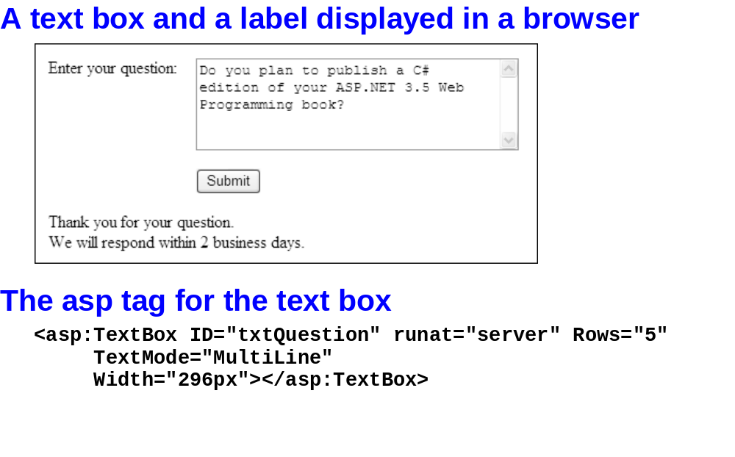
© 2011, Mike Murach & Associates, Inc.
Slide <number>

Slide 25
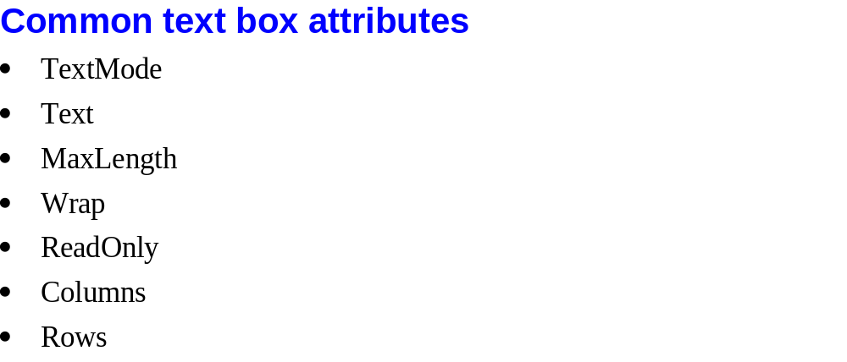
© 2011, Mike Murach & Associates, Inc.
Slide <number>

Slide 26
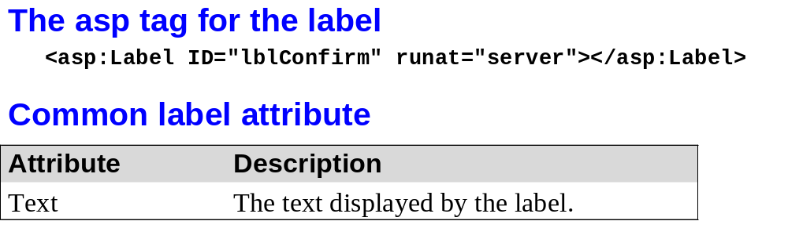
© 2011, Mike Murach & Associates, Inc.
Slide <number>

Slide 27


© 2011, Mike Murach & Associates, Inc.
Slide <number>

Slide 28
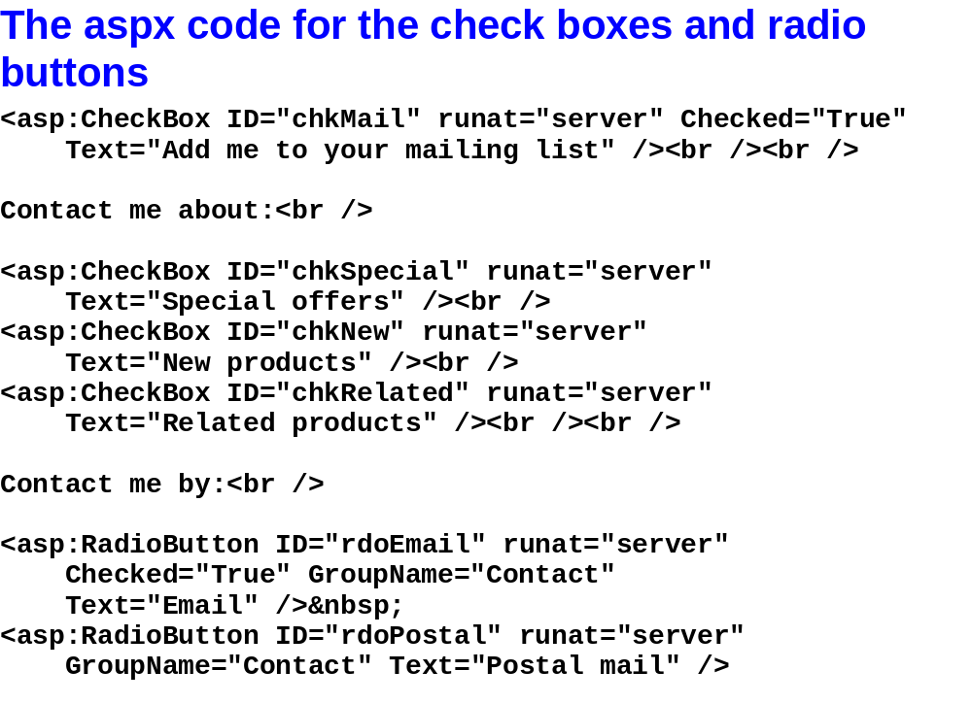
© 2011, Mike Murach & Associates, Inc.
Slide <number>

Slide 29
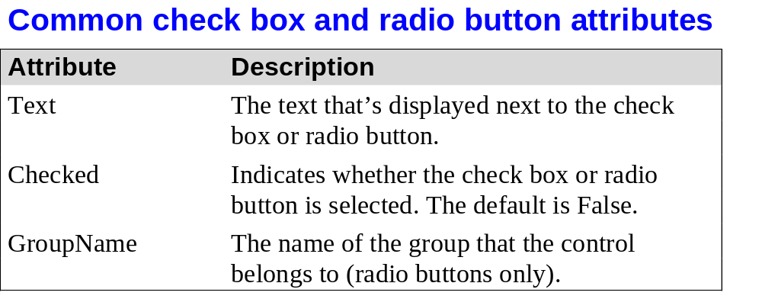
© 2011, Mike Murach & Associates, Inc.
Slide <number>

Slide 30
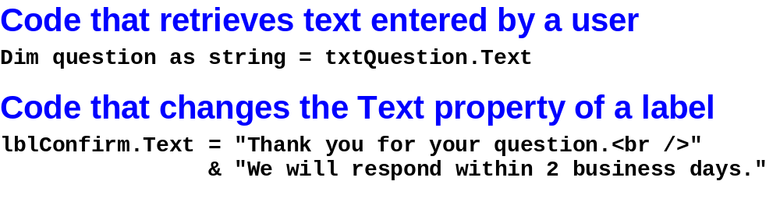
© 2011, Mike Murach & Associates, Inc.
Slide <number>

Slide 31
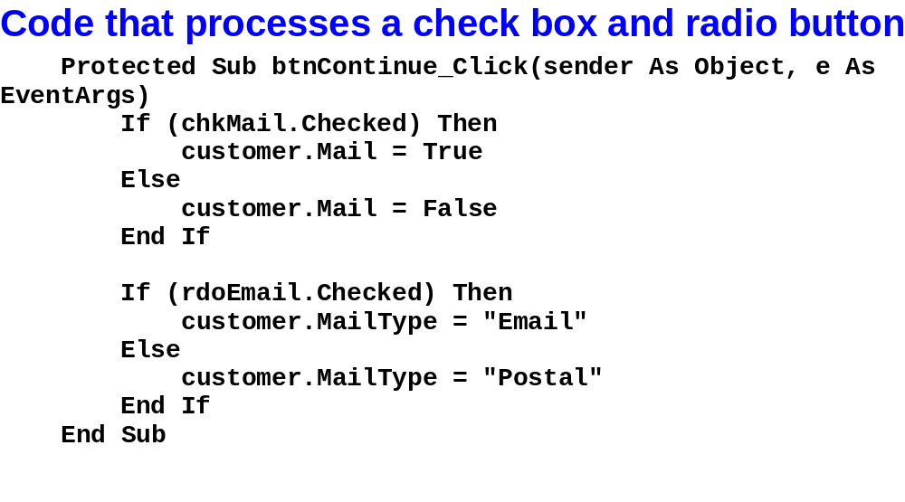
© 2011, Mike Murach & Associates, Inc.
Slide <number>

Slide 32
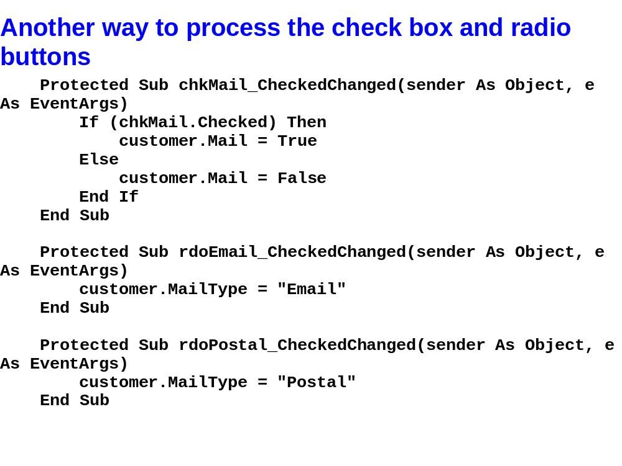
© 2011, Mike Murach & Associates, Inc.
Slide <number>

Slide 33

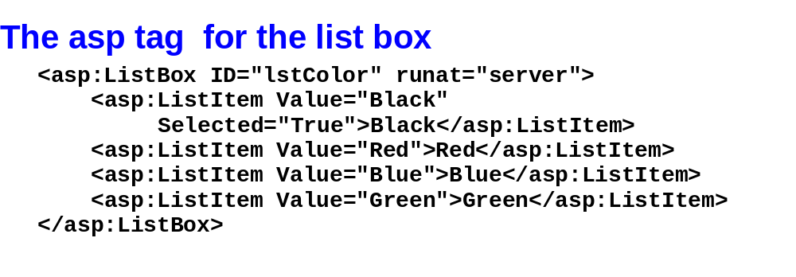
© 2011, Mike Murach & Associates, Inc.
Slide <number>

Slide 34
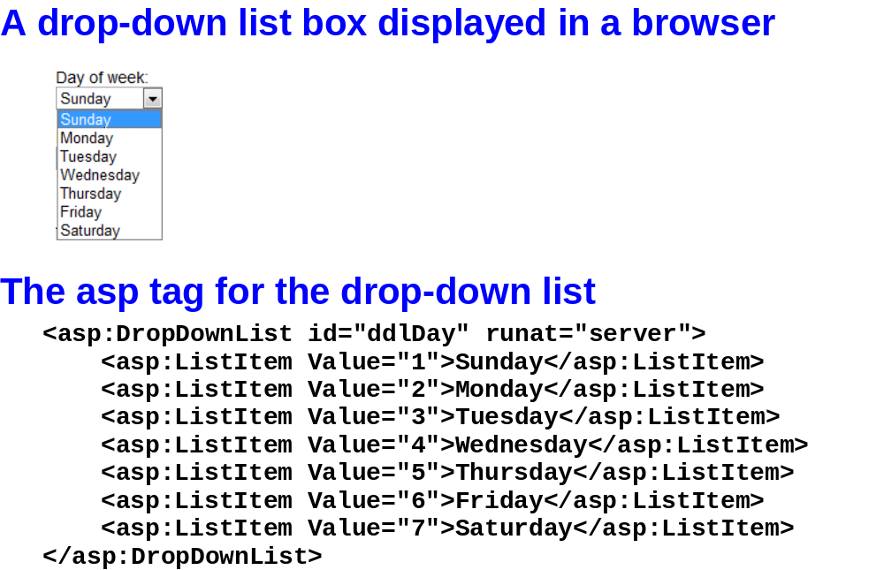
© 2011, Mike Murach & Associates, Inc.
Slide <number>

Slide 35
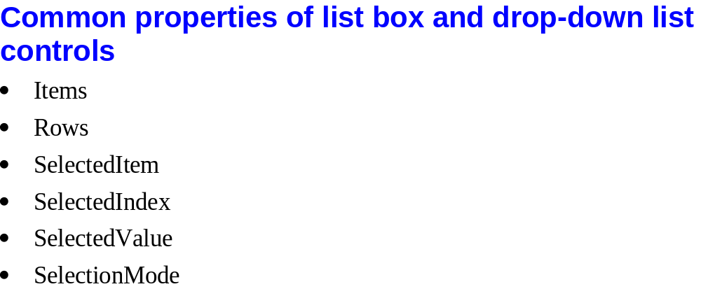
© 2011, Mike Murach & Associates, Inc.
Slide <number>

Slide 36
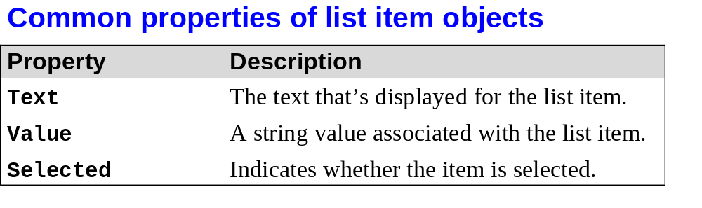
© 2011, Mike Murach & Associates, Inc.
Slide <number>

Slide 37
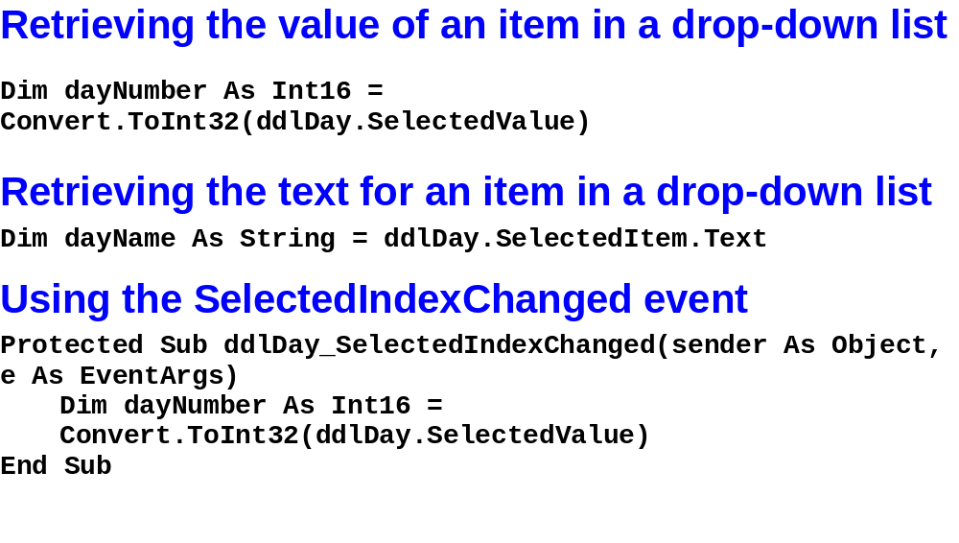
© 2011, Mike Murach & Associates, Inc.
Slide <number>

Slide 38
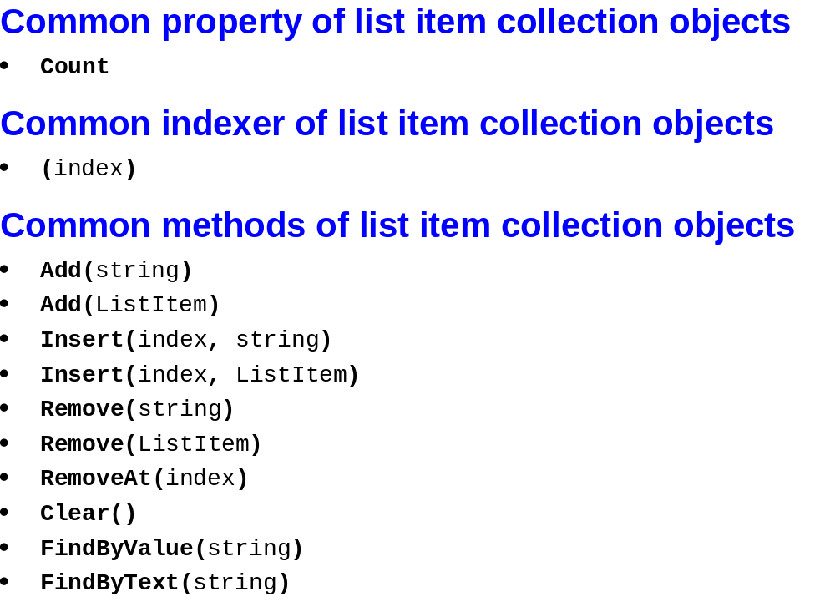
© 2011, Mike Murach & Associates, Inc.
Slide <number>

Slide 39
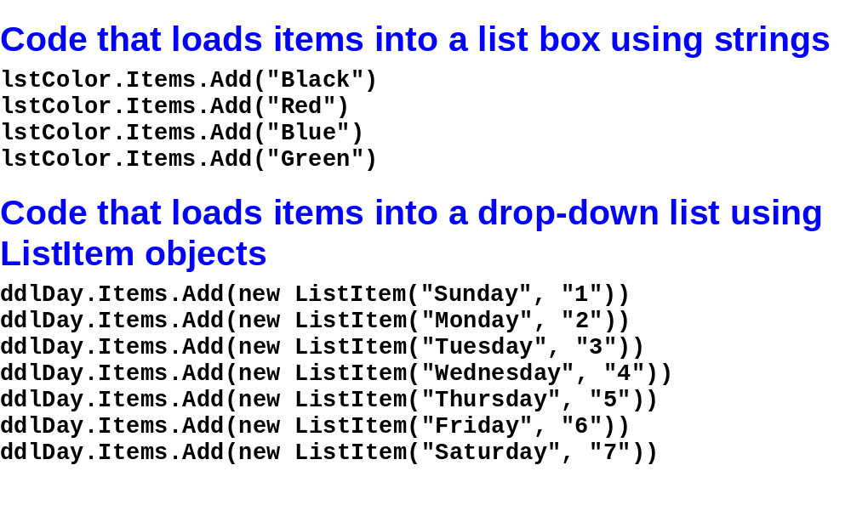
© 2011, Mike Murach & Associates, Inc.
Slide <number>

Slide 40
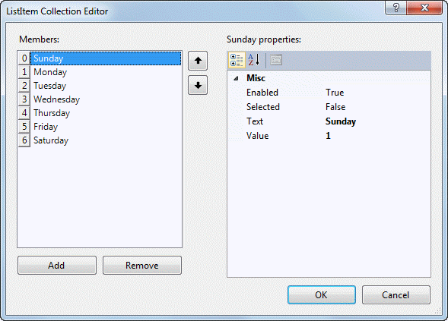
© 2011, Mike Murach & Associates, Inc.
Slide <number>

Slide 41

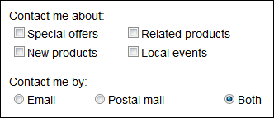
© 2011, Mike Murach & Associates, Inc.
Slide <number>

Slide 42
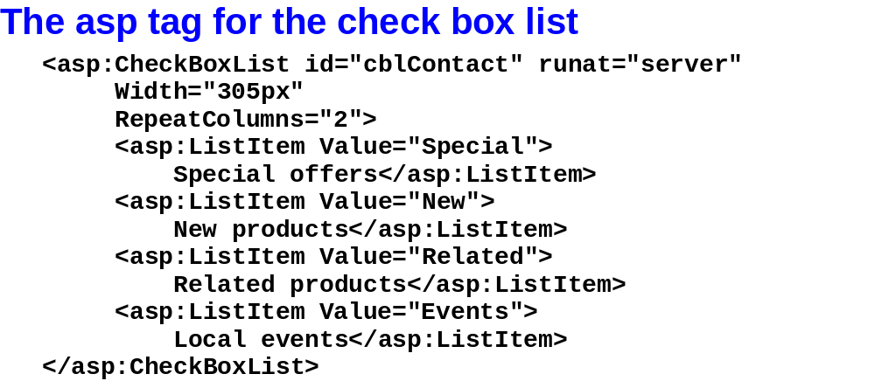
© 2011, Mike Murach & Associates, Inc.
Slide <number>

Slide 43
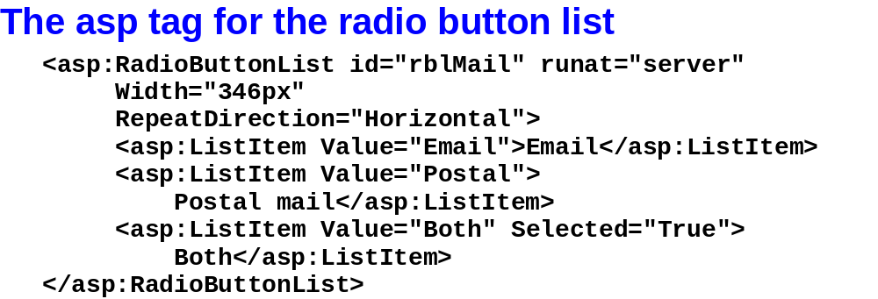
© 2011, Mike Murach & Associates, Inc.
Slide <number>

Slide 44
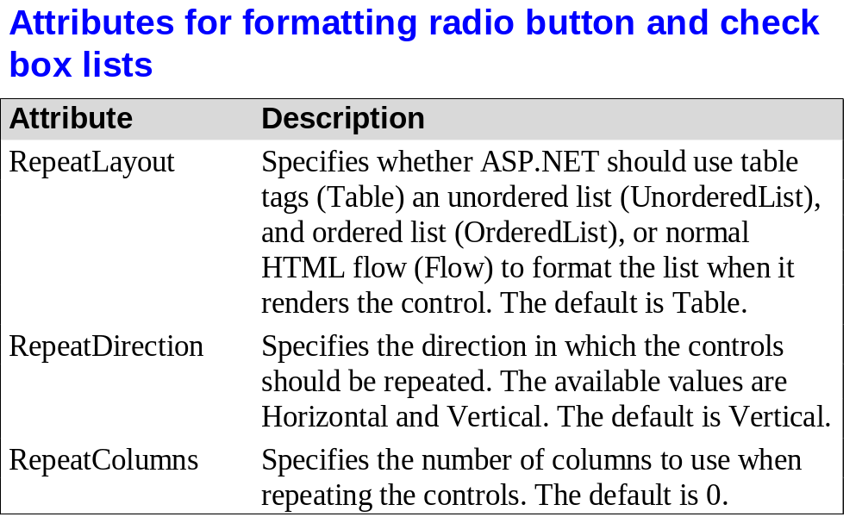
© 2011, Mike Murach & Associates, Inc.
Slide <number>

Slide 45
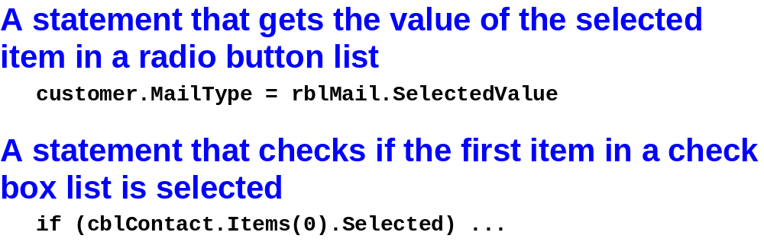
© 2011, Mike Murach & Associates, Inc.
Slide <number>

Slide 46

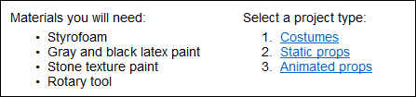
© 2011, Mike Murach & Associates, Inc.
Slide <number>

Slide 47
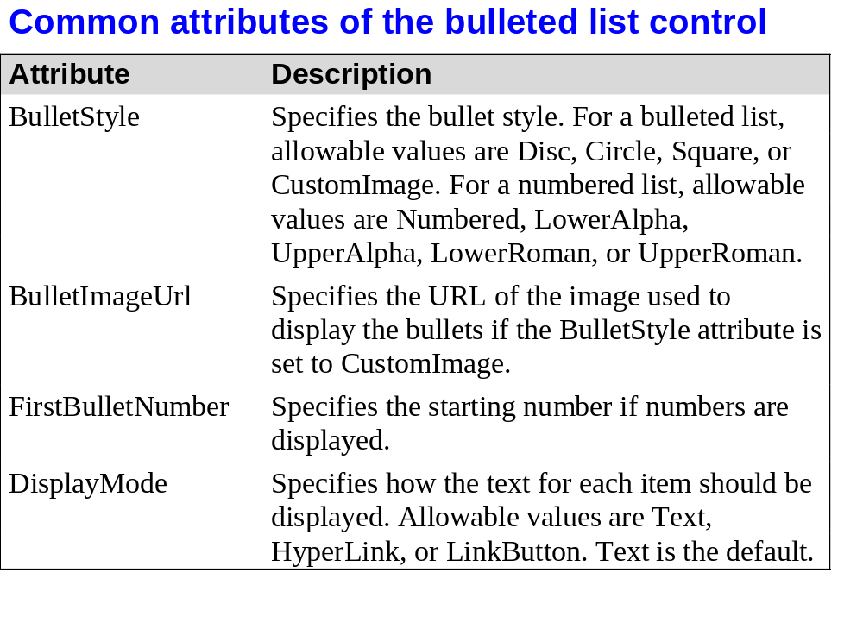
© 2011, Mike Murach & Associates, Inc.
Slide <number>

Slide 48
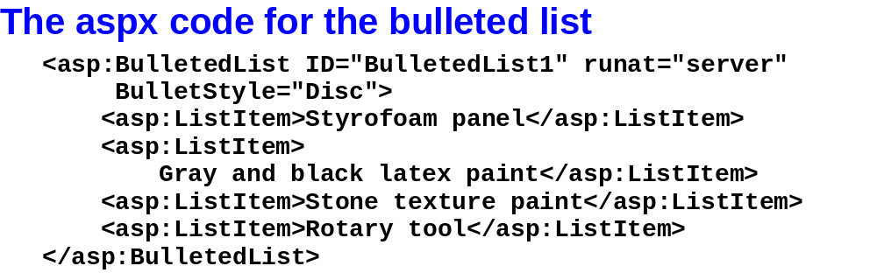
© 2011, Mike Murach & Associates, Inc.
Slide <number>

Slide 49
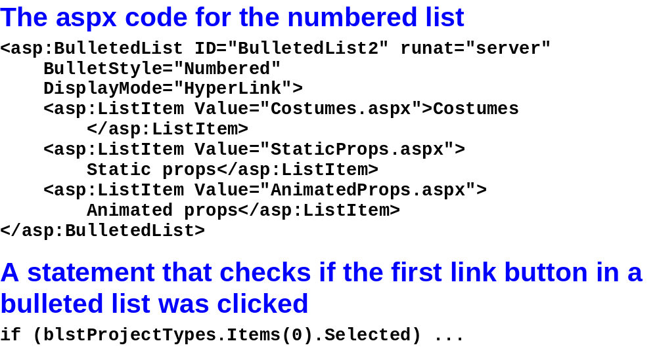
© 2011, Mike Murach & Associates, Inc.
Slide <number>

Slide 50

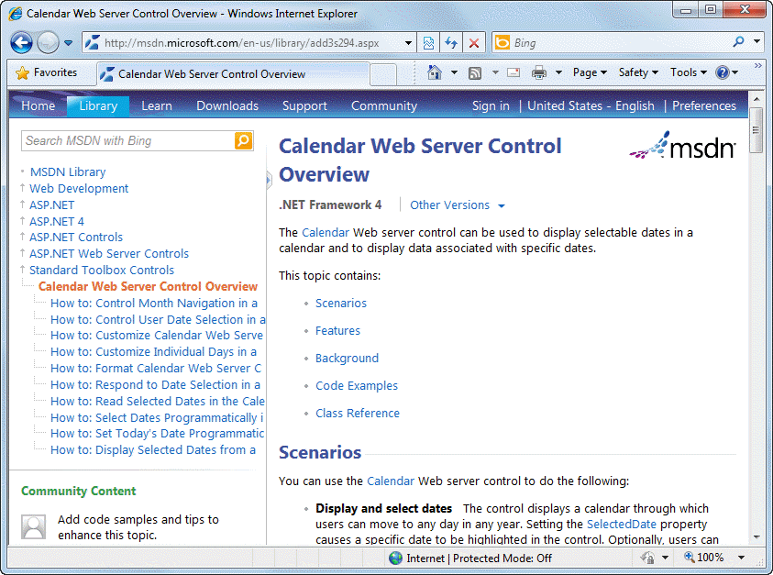
© 2011, Mike Murach & Associates, Inc.
Slide <number>

Slide 51
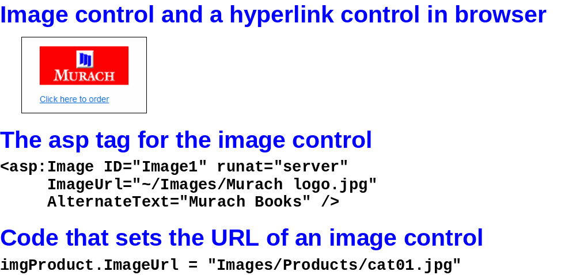
© 2011, Mike Murach & Associates, Inc.
Slide <number>

Slide 52
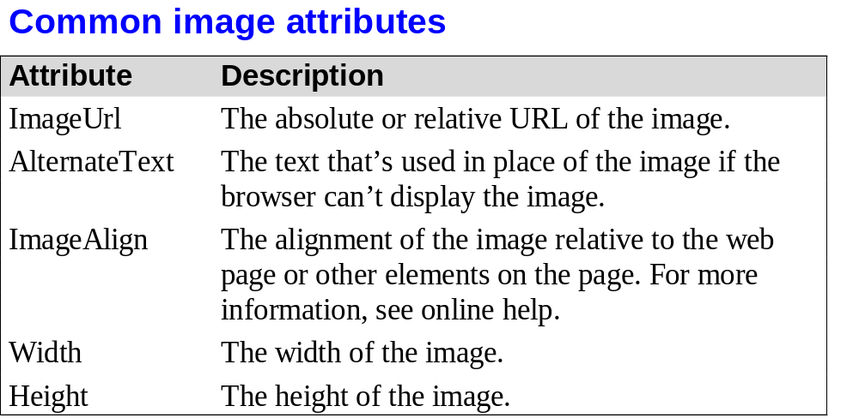
© 2011, Mike Murach & Associates, Inc.
Slide <number>

Slide 53

© 2011, Mike Murach & Associates, Inc.
Slide <number>

Slide 54


© 2011, Mike Murach & Associates, Inc.
Slide <number>

Slide 55

© 2011, Mike Murach & Associates, Inc.
Slide <number>

Slide 56

© 2011, Mike Murach & Associates, Inc.
Slide <number>

Slide 57

© 2011, Mike Murach & Associates, Inc.
Slide <number>

Slide 58

© 2011, Mike Murach & Associates, Inc.
Slide <number>

Slide 59

© 2011, Mike Murach & Associates, Inc.
Slide <number>

Slide 60



© 2011, Mike Murach & Associates, Inc.
Slide <number>

Slide 61

© 2011, Mike Murach & Associates, Inc.
Slide <number>

Slide 62


© 2011, Mike Murach & Associates, Inc.
Slide <number>

Slide 63

© 2011, Mike Murach & Associates, Inc.
Slide <number>

Slide 64

© 2011, Mike Murach & Associates, Inc.
Slide <number>

Slide 65

© 2011, Mike Murach & Associates, Inc.
Slide <number>

